Slide 1
Maven 2.0
Project management and comprehension tool

Slide 2
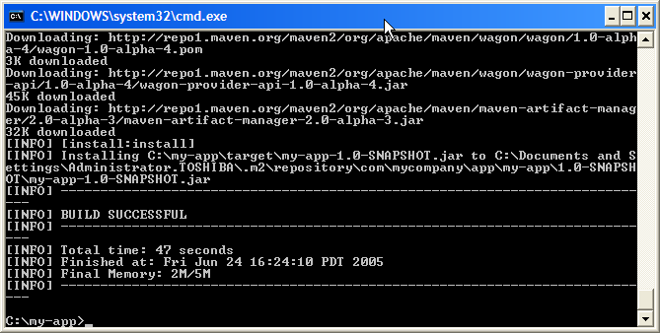
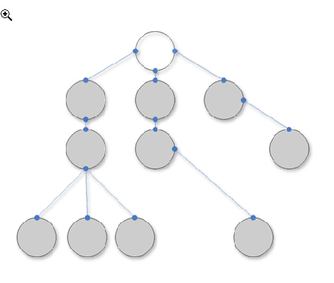
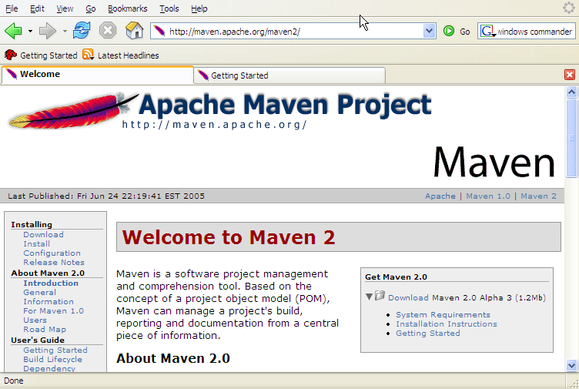
What is Maven?
A build tool
A dependency management tool
A documentation tool

Slide 3
Apply patterns to project build infrastructure
Maven is really a process of applying patterns to a build infrastructure in order to provide a coherent view of software projects.
Provides a way to help with managing:
  Builds
  Documentation
  Reporting
  Dependencies
  Software Configuration Management
  Releases
  Distribution

Slide 4
Objectives
Make the development process visible or transparent
Provide an easy way to see the health and status of a project
Decreasing training time for new developers
Bringing together the tools required in a uniform way
Preventing inconsistent setups
Providing a standard development infrastructure across projects
Focus energy on writing applications

Slide 5
Benefits
Standardization
Fast and easy to set up a powerful build process
Greater momentum vs. Ant – it is now becoming legacy and not moving fast ahead.
Maven 2 is recent and much more refined than Maven 1
Dependency management (automatic downloads)
Project website generation, Javadoc
Repository management

Slide 6
Maven Architecture
Plugin
e.g. jar
Projects
to build
Maven Core
Plugin
e.g. surefire
Plugin
e.g. release
Local machine
Remote repository or local install

Slide 7
Common project metadata format
POM = Project Object Model = pom.xml
Contains metadata about the project
  Location of directories, Developers/Contributors, Issue tracking system, Dependencies, Repositories to use, etc
Example:
<project>
<modelVersion>4.0.0</modelVersion>
<groupId>org.codehaus.cargo</groupId>
<artifactId>cargo-core-api-container</artifactId>
<name>Cargo Core Container API</name>
<version>0.7-SNAPSHOT</version>
<packaging>jar</packaging>
<dependencies/>
<build/>
[…]
Minimal POM

Slide 8
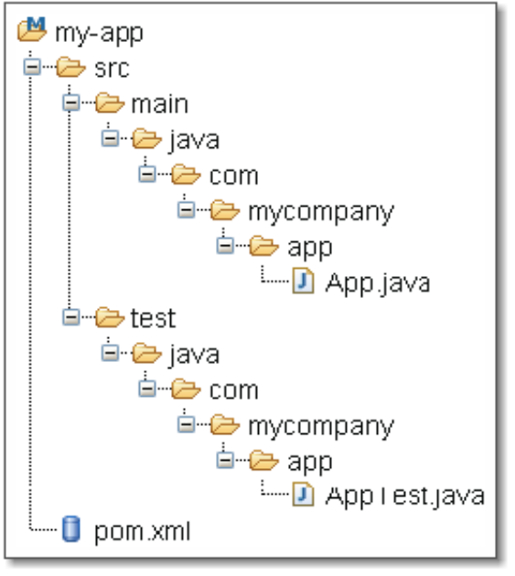
Standard directory organization
Having a common directory layout would allow for users familiar with one Maven project to immediately feel at home in another Maven project.
src/main/java
Application/Library sources
src/main/resources
Application/Library resources
src/main/filters
Resource filter files
src/main/assembly
Assembly descriptors
src/main/config
Configuration files
src/main/webapp
Web application sources
src/test/java
Test sources
src/test/resources
Test resources
src/test/filters
Test resource filter files
src/site
Site
LICENSE.txt
Project's license
README.txt
Project's readme

Slide 9

Common way to build applications
M2
generate-
sources
mojo
compile
mojo
test
mojo
package
plugins
integration-
test
user
mojo
install
mojo
e.g. mvn install
deploy
bindings
Well-known phases
MOJO – Maven 2 Plugins Project
http://mojo.codehaus.org/

Slide 10
Artifact repositories (1/3)
Used to store all kind of artifacts
  JARs, EARs, WARs, NBMs, EJBs, ZIPs, plugins, …
All project interactions go through the repository
  No more relative paths!
  Easy to share between team
Local
Artifact
Repository
Remote
Artifact
Repository
e.g. http://ibiblio.org/maven2
<repositories>
<repository>
<id>maven2-snapshot</id>
<releases>
<enabled>true</enabled>
</releases>
<name>Maven Central Development Repository</name>
<url>http://snapshots.maven.codehaus.org/maven2</url>
<layout>legacy|default</layout>
</repository>
</repositories>

Slide 11
Artifact repositories (2/3)
Some public remote repositories
ibiblio
m1
ibiblio
m2
Conversion + sync
JIRA upload
requests
m1
JIRA upload
requests
m2
sync
sync + conversion
Codehaus
m1
ObjectWeb
m1
Apache
m1
Jetty
m1
Open
Symphony
m1
OS Java
m1
partners

Slide 12
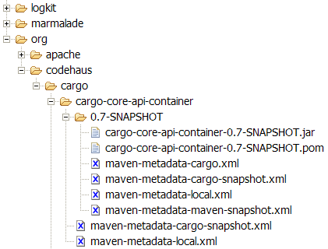
Artifact repositories (3/3)
Hierarchical structure
Automatic plugin download
Plugins are read directly from the repository
Configurable strategies for checking the remote repositories for updates
  Daily check by default for plugin and ranges updates
Remote repositories contain Metadata information
  Releases, latest, and more to come

Slide 13
Dependency management (1/2)
Maven uses binary dependencies
« any version after 1.0 »
A
B
<dependencies>
<dependency>
<groupId>com.acme</groupId>
<artifactId>B</artifactId>
<version>[1.0,)</version>
<scope>compile</scope>
</dependency>
</dependencies>
C
Artifact
Repository
(Local)
Artifact
Repositories
(Remote)
Build C
Look for A & B
Look for A & B

Slide 14
Dependency management (2/2)
Transitive dependencies
  Possibility to exclude some depndencies
  Need good metadata
  Ideally projects should be split
SNAPSHOT handling
  Always get latest
Automatic dependency updates
  By default every day
A
Only need to include A
B
C
D

Slide 15
Installation and Setup
Download Maven 2 from http://maven.apache.org/
Add Maven’s bin directory to PATH
Ensure JAVA_HOME is set to SDK
Run mvn –version to test install
C:\Documents and Settings\alina>mvn -version
Maven version: 2.0.7
Java version: 1.5.0_08
OS name: "windows xp" version: "5.1" arch: "x86"

Slide 16
Configuring a proxy
Configure a proxy to use for some or all of your HTTP requests in Maven 2.0 in ${user.home}/.m2/settings.xml:
<settings>
.
<proxies>
<proxy>
<active>true</active>
<protocol>http</protocol>
<host>proxy.somewhere.com</host>
<port>8080</port>
<username>proxyuser</username>
<password>somepassword</password>
<nonProxyHosts>www.google.com|*.somewhere.com</nonProxyHosts>
</proxy>
</proxies>
.
</settings>
http://maven.apache.org/guides/mini/guide-proxies.html

Slide 17
Creating a project
In test directory execute the following command:
mvn archetype:create
-DgroupId=com.mycompany.app -DartifactId=my-app
The archetype:create signals to create a project with a standard file structure.
Notice that dependencies download automatically, and directory structure is created accordingly
An additional parameter is available that’ll select a specific template, like:
  -DarchetypeArtifactId=maven-archetype-webapp for instance

Slide 18
Compiling a project
> mvn compile
[INFO] -----------------------------------------------
[INFO] Building Maven Quick Start Archetype
[INFO] task-segment: [compile]
[INFO] -----------------------------------------------
[INFO] artifact org.apache.maven.plugins:maven-resources-plugin: \
checking for updates from central
...
[INFO] artifact org.apache.maven.plugins:maven-compiler-plugin: \
checking for updates from central
...
[INFO] [resources:resources]
...
[INFO] [compiler:compile]
Compiling 1 source file to <dir>/my-app/target/classes
[INFO] ------------------------------------------------
[INFO] BUILD SUCCESSFUL
[INFO] ------------------------------------------------
[INFO] Total time: 3 minutes 54 seconds
[INFO] Finished at: Fri Sep 23 15:48:34 GMT-05:00 2005
[INFO] Final Memory: 2M/6M

Slide 19
Generating Eclipse project files
To generate the Eclipse project files from your POM execute the following command:
mvn eclipse:eclipse
Command generates the following Eclipse configuration files:
  .project and .classpath files
  .setting/org.eclipse.jdt.core.prefs with project specific compiler settings
  various configuration files for WTP (Web Tools Project)

Slide 20
The local repository
What does M2 do with all the dependencies?
C:\Documents and Settings\Username\.m2
Advantages: No need to keep anything in the repo other than your own source code, saves space in the repo and rebuild / transfer time
Can download dependencies from a local intranet repo instead of ibiblio, etc
Eclipse needs to know the path to the local Maven repository. Therefore the classpath variable M2_REPO has to be set:
  Java > Build Path > Classpath Variables

Slide 21
Installing JARs to local repository
Sometimes you need to put some specific JARs in your local repository for use in your builds
The JARs must be placed in the correct place in order for it to be correctly picked up by Maven
To install a JAR in the local repository use the following command:
Now can include
dependency in
pom.xml:
mvn install:install-file -Dfile=<path-to-file> -DgroupId=<group-id> \
-DartifactId=<artifact-id> -Dversion=<version> -Dpackaging=jar
<dependency>
<groupId><group-id></groupId>
<artifactId><artifact-id></artifactId>
<version><version></version>
</dependency>

Slide 22
Repositories for auto-downloads
Repository usage is transparent to Maven
By default, Maven looks up ibiblio
Override in the pom.xml (example below with the Eclipse plugin)
<project>
...
<repositories>
<repository>
<id>m2 plugin</id>
<url>m2eclipse.codehaus.org</url>
</repository>
</repositories>
...
</project>
Plugins available to use CVS with the project source
Ibiblio.org - Public library and digital archive

Slide 23
Plugin for Eclipse
Help → Software Updates → Search & Install
Remote Site
Name: m2 plugin
URL: http://m2eclipse.codehaus.org
Will list newest version
Wait for download to complete
The URL also has Flash demos

Slide 24
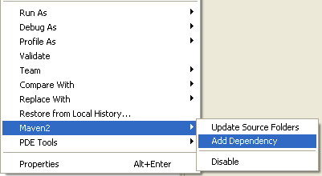
Using from Eclipse
Enable Maven:
  right click on the project → Maven 2 → Enable
Add dependency:
  right click on the project
  → Maven 2 → Add Dependency
Executing goals:
  right click pom.xml and ‘Run As → Maven2 build’ to set a goal
It’s possible to debug during the build process

Slide 25
Overview of common Goals
validate - validate the project is correct and all necessary information is available
compile - compile the source code of the project
test - test the compiled source code using a suitable unit testing framework. These tests should not require the code be packaged or deployed
package - take the compiled code and package it in its distributable format, such as a JAR
integration-test - process and deploy the package if necessary into an environment where integration tests can be run
install - install the package into the local repository, for use as a dependency in other projects locally
deploy - done in an integration or release environment, copies the final package to the remote repository for sharing with other developers and projects

Slide 26
Creating project website
Right click the pom file, run as to set goal
Enter “site” this time as the goal
Let the build run, it’ll start downloading and creating things left and right
Eventually in the target dir you end up with a \site dir, with an apache-style project website
Javadoc, various reports, and custom content can be added

Slide 27
Website features
Continuous Integration
Dependencies (junit is listed)
Issue Tracking
Mailing Lists
Project License
Project Team
Source Repository

Slide 28
More stuff
Automatically generate reports, diagrams, and so on through Maven / the project site
Internationalization – create different language project websites
Create projects within projects (more pom.xml files inside sub dirs\jars), with different build stats and so on
Maven can make .war files, EJBs, etc.

Slide 29
Using Maven Plugins
Whenever you want to customise the build for a Maven project, this is done by adding or reconfiguring plugins
For example, configure the Java compiler to allow JDK 5.0 sources
Plugins in
Maven 2.0
look much like
a dependency
...
<build>
<plugins>
<plugin>
<groupId>org.apache.maven.plugins</groupId>
<artifactId>maven-compiler-plugin</artifactId>
<configuration>
<source>1.5</source>
<target>1.5</target>
</configuration>
</plugin>
</plugins>
</build>
...

Slide 30
Maven 2 Plugins
AlmostPlainText
Maven Axis
Maven Cobertura
Maven DB2
Dbunit
Debian Package
Maven DotUml
Doxygen
Maven Files
FindBugs
Maven flash
Help
Maven IzPack
Java Application
Maven JAVANCSS
Maven JAXB
JUNITPP
Kodo
Maven Macker
SDocBook
Sourceforge
Maven SpringGraph
RPM Plugin
Runtime Builder
Strutsdoc
Tasks
Maven Transform
Maven UberDist
Maven Vignette
WebSphere 4.0
WebSphere 5 (5.0/5.1)
Maven WebLogic
Canoo WebTest
Wiki
Word to HTML
XML Resume
Maven DotUml
Middlegen
Maven News

Slide 31
Archetypes
For reuse, create archetypes that work as project templates with build settings, etc
An archetype is a project, with its own pom.xml
An archetype has a descriptor called archetype.xml
Allows easy generation of Maven projects
http://www.ibiblio.org/maven2/org/apache/maven/archetypes/

Slide 32
Good things about Maven
Standardization
Reuse
Dependency management
Build lifecycle management
Large existing repository
IDE aware
One directory layout
A single way to define dependencies
Setting up a project is really fast
Transitive dependencies
Common build structure
Use of remote repository
Web site generation
Build best practices enforcement
Automated build of application
Works well with distributed teams
All artifacts are versioned and are stored in a repository
Build process is standardized for all projects
A lot of goals are available
It provides quality project information with generated site
Easy to learn and use
Makes the build process much easier at the project level
Promotes modular design of code

Slide 33
References
Maven Home
http://maven.apache.org/
Maven Getting Started Guide
http://maven.apache.org/guides/getting-started/index.html
Steps for creating a Maven-based Website
http://www.javaworld.com/javaworld/jw-02-2006/jw-0227-maven_p.html
Maven 2 Plugins Project
http://mojo.codehaus.org/
Maven Integration for Eclipse
http://m2eclipse.codehaus.org/

